Slide 1


Movie Ratings Problem

Slide 2

Course Code: CSE325
Course Title: Operating Systems
Section: 01
Presented By
Name: Najnin Sultana Nishu
Id: 2020-1-60-152; Roll: 25
Name: Md Tahsin
Id: 2020-2-60-112; Roll: 34
Name: Sadia Rahman Ani
Id: 2020-2-60-172; Roll: 36
Presented To
Dr. Md. Nawab Yousuf Ali Professor
Department of Computer Science & Engineering

Slide 3
Abstract
Movie rating problems deals with all kind of movie details, search movies in decreasing order of popularity ratings and print all movies too.
This project will ensure to find movie quality easier, faster and safer. This project will save both paper and time of authority and people.
We have a set of processes in this project that search the movie database from keywords.
To solve this problem we need to use process ,thread and semaphore.

Slide 4
Introduction
A process is defined as an entity which represents the basic unit of work to be implemented in the system. There are 5 basic state of the process.
start
ready
running
terminated
wait
A thread is a path of execution within a process. A process can contain multiple threads.
Semaphores are integer variables that are used to solve the critical section problem by using two atomic operations, wait and signal that are used for process synchronization.

Slide 5
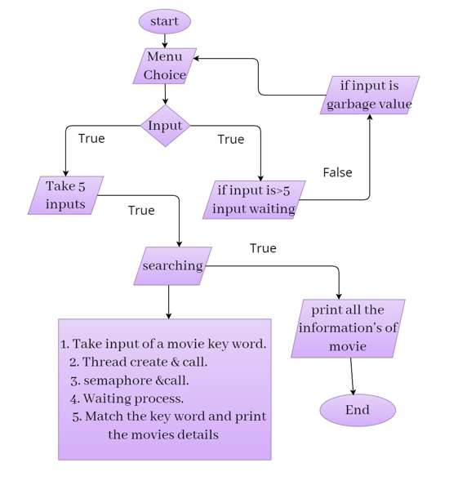
Flow chart
Step1: Start
Step2: Menu choice
Step3:input
Step4: True. Then then take input 5 and go to step 6.
True. But if input is greater than 5 then the process is in waiting list and go to the step 5.
Step5: If input is garbage value the go to the step 2.
Step6: searching.
Step7: Print all the information of the movies.
Step8: End

Slide 6
Searching Function
count++;
pthread_mutex_unlock(&lock1);
sem_wait(&key);
printf("\nProcess %d has started searching\n",pthread_self());
_sleep(1);
printf("\nProcess %d searching for %s\n",pthread_self(),title);
info(title,pthread_self());
printf("\nProcess%d finished it's search\n\n",pthread_self());
sem_post(&key);
}
void *search(void *title)
{
sem_wait(&in);
printf("\nProcess %d reached\n",pthread_self());
_sleep(1);
printf("\n");
pthread_mutex_lock(&lock1);
if(count>=5)
{
printf("\nProcess %d is waiting to search\n", pthread_self());
}

Slide 7
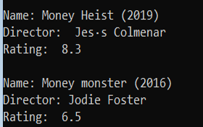
void info(char ch[],int no)
{
if(ch[0]=='s' && ch[1]=='t' && ch[2]=='a' && ch[3]=='r') //Star
{
printf("\n3 match found for Process : %d , keyword : %s\n",no,ch);
printf("\nName: My love from another star (2015)\n");
printf("Director: Yoon Hye Jin \n");
printf("Rating: 8.9\n\n");
printf("\nName: Where stars land (2018)\n");
printf("Director: Kim Soobin \n");
printf("Rating: 8.0\n\n");
printf("\nName: Falling like the stars (2019)\n");
printf("Director: Patrick Mason \n");
printf("Rating: 5.0\n\n");
printf("................\n");
}
else if(ch[0]=='m' && ch[1]=='o' && ch[2]=='n' && ch[3]=='e' && ch[4]=='y') //money
{
printf("\n2 match found for Process : %d , keyword : %s\n",no,ch);
printf("\nName: Money Heist (2019) \n");
printf("Director: Jesús Colmenar \n");
printf("Rating: 8.3\n\n");
printf("Name: Money monster (2016)\n");
printf("Director: Jodie Foster \n");
printf("Rating: 6.5\n");
printf("................\n");
}

Slide 8
else if(ch[0]=='g' && ch[1]=='u' && ch[2]=='a' && ch[3]=='r' && ch[4]=='d' && ch[5]=='i' && ch[6]=='a' && ch[7]=='n') //Guardian
{
printf("\n3 match found for Process : %d , keyword : %s\n",no,ch);
printf("\nName: Guardian: The Lonely and Great God (2016)\n");
printf("Director: Lee Eung-bok \n");
printf("Rating: 8.6n\n");
printf("\nName: Guardians of the Galaxy (2014)\n");
printf("Director: James Gunn \n");
printf("Rating: 8.0n\n");
printf("\nName: The invisible guardian (2017)\n");
printf("Director: Fernando González Molina \n");
printf("Rating: 6.0\n");
printf("................\n");
}
else if (ch[0]=='d' && ch[1]=='a' && ch[2]=='r' && ch[3]=='k' ) //dark
{
printf("\n4 match found for Process : %d , keyword : %s\n",no,ch);
printf("\nName: The Dark Knight (2008)\n");
printf("Director: Christopher Nolan\n");
printf("Rating: 9\n\n");
printf("\nName: Dark(2017)\n");
printf("Director: Baran bo Odar, Jantje Friese\n");
printf("Rating: 8.8\n\n");
printf("\nName: The Dark Knight Rises (2012)\n");
printf("Director: Christopher Nolan\n");
printf("Rating: 8.4\n\n");
printf("\nName: The dark (2018)\n");
printf("Director: Justin P. Lange \n");
printf("Rating: 5.4\n\n");
printf("................\n");
}

Slide 9
else if (ch[0]=='w' && ch[1]=='a' && ch[2]=='t' && ch[3]=='e' && ch[4]== 'r') //water
{
printf("\n1 match found for Process : %d , keyword : %s\n",no,ch);
printf("\nName: Under Water (2020)\n");
printf("Director: William Eubank\n");
printf("Rating: 5.8\n\n");
printf("................\n");
}
else if (ch[0]=='m' && ch[1]=='a' && ch[2]=='n') //man
{
printf("\n2 match found for Process : %d , keyword : %s\n",no,ch);
printf("\nName: Spider-Man (2002)\n");
printf("Director: Sam Raimi\n");
printf("Rating: 7.3\n\n");
printf("\nName: The invisible man (2020)\n");
printf("Director: Leigh Whannell\n");
printf("Rating: 7.1\n\n");
printf("................\n");
}
else{
printf("\nNo match found for Process : %d , keyword : %s\n",no,ch);
}
}

Slide 10
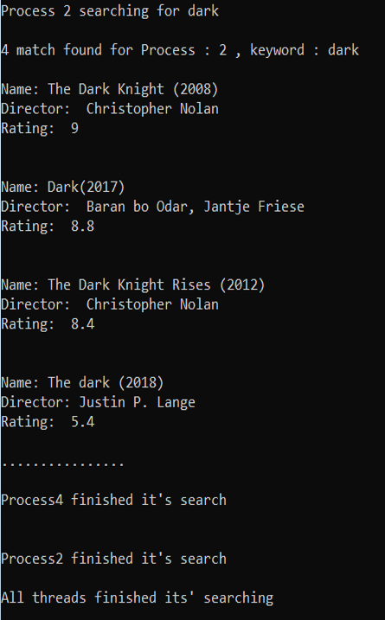
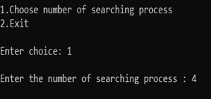
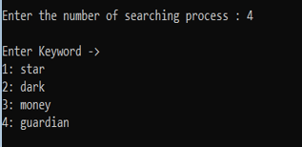
Main function
for(i=1; i<=n; i++)
{
printf("%d: ",i);
scanf("%s",m[i]);
pthread_create(&movie[i],
NULL,search,(void*)&m[i]);
getchar();
if(i==n)
{
for(j=0; j<n; j++)
sem_post(&in);
} }
printf("\n");
for(i=0; i<n; i++)
{
pthread_join(movie[i],NULL);
}
printf("All threads finished its' searching \n");
}
else
{
exit(0);
}}}
int main()
{
int choice ;
while(1)
{
printf("\n\t\t\t\t............Menu..............\n");
printf("\n1.Choose number of searching process \n2.Exit\n");
printf("\nEnter choice: ");
scanf("%d",&choice);
if(choice==1)
{
printf("\nEnter the number of searching process : ");
scanf("%d",&n);
printf("\n");
int i,j,c=0;
sem_init(&key,0,5);
sem_init(&in,0,0);
pthread_mutex_init(&lock1,0);
pthread_t movie[n];
char m[n][100];
printf("Enter Keyword -> \n");

Slide 11
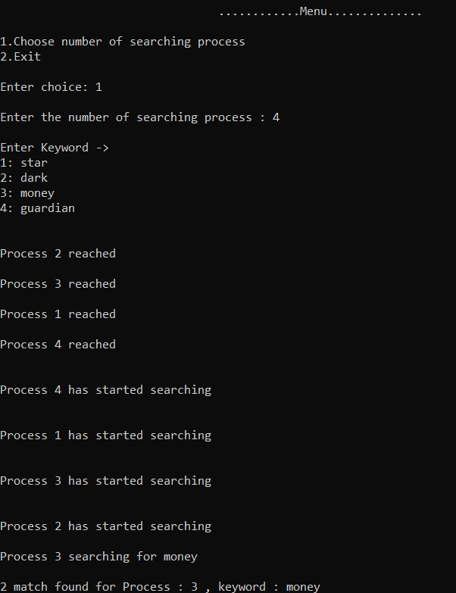
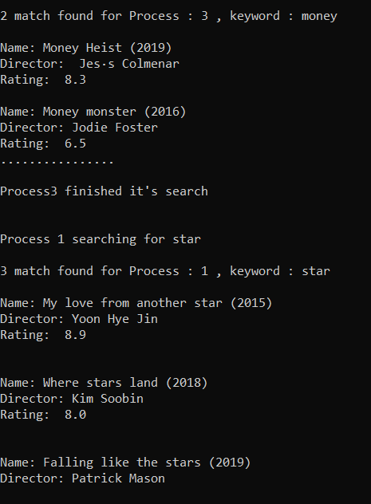
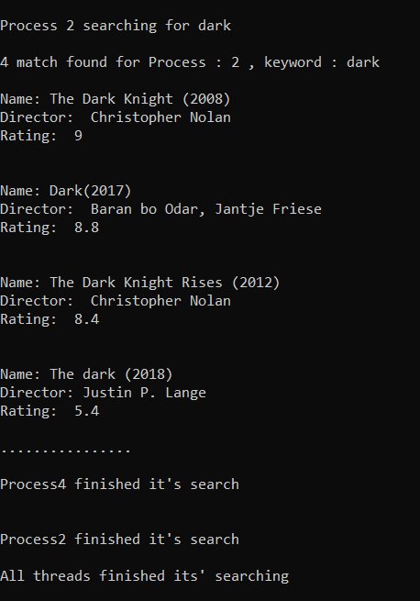
Result

Slide 12
Summary
As this project is designed for movie rating, people can be benefited from this. It does not become overloaded by many search processes, allow at most five processes at a time, when a sixth or more process attempts to make a search, it has to wait until one or more running search processes finish working . When all process are done , the program will be stop.

Slide 13

Thank You!

